Slide 1


DON BOSCO INSTITUTE OF TECHNOLOGY
DEPARTMENT OF INFORMATION SCIENCE & ENGINEERING
Academic year 2020-2021
TECHNICAL SEMINAR
Motion Detection And Temperature Observing
BATCH NO | NAME | USN
2 | Swaraj | 1DB15IS053
Project Guide - Mrs Gowramma G S
Associate professor and HOD
Information Science and Engineering
Don Bosco Institute of Technology

Slide 2
CONTENT
Introduction & Component Used
IoT
Tools and Packages
Block Diagram
Methodology
Conclusion

Slide 3
Introduction
In this time of COVID -19 , everyone is afraid from its transmission and people are more careful and people will allow less movement but for necessary items we must have to go out or do any type of movement .so this project basically detect movement and as soon as movement detected it will show the temperature on a display
Component Used
Arduino
PIR Sensor
Buzzer
Temperature sensor (TMP36)
Jumper wire
Potentiometer
LCD display
Bread Board

Slide 4
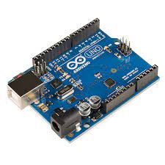
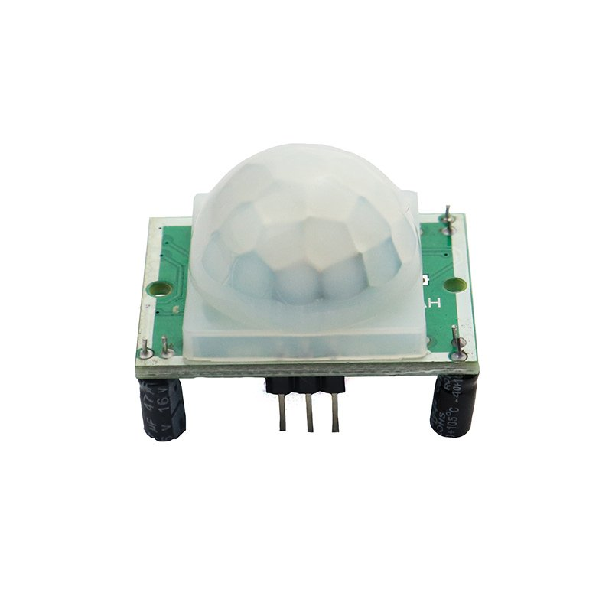
Component Used
Arduino
Arduino is an open-source hardware and software company, project and user community that designs and manufactures single-board microcontrollers and microcontroller kits for building digital devices.
PIR Sensor
PIR sensors allow you to sense motion, almost always used to detect whether a human has moved in or out of the sensors range. They are small, inexpensive, low-power, easy to use and don't wear out
PIR sensor
ARDUINO

Slide 5
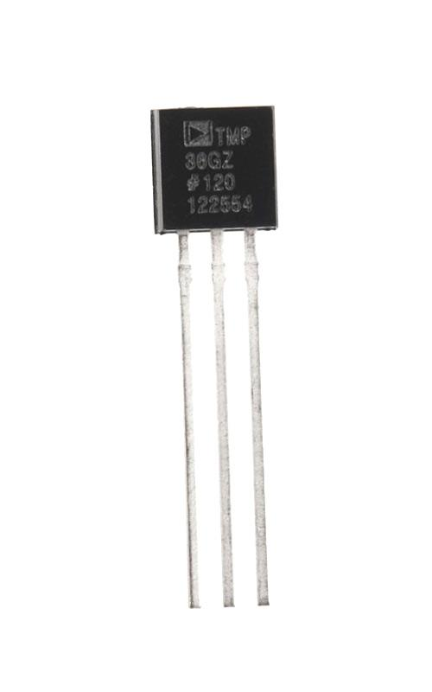
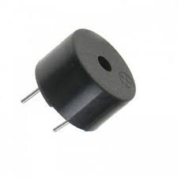
Component Used
Buzzer
A buzzer or beeper is an audio signalling device, which may be mechanical, electromechanical, or piezoelectric (piezo for short). Typical uses of buzzers and beepers include alarm devices, timers, and confirmation of user input such as a mouse click or keystroke
Temperature sensor (TMP36)
The TMP35/TMP36/TMP37 are low voltage, precision centi- grade temperature sensors. They provide a voltage output that is linearly proportional to the Celsius (centigrade) temperature.
BUZZER
TMP 36

Slide 6
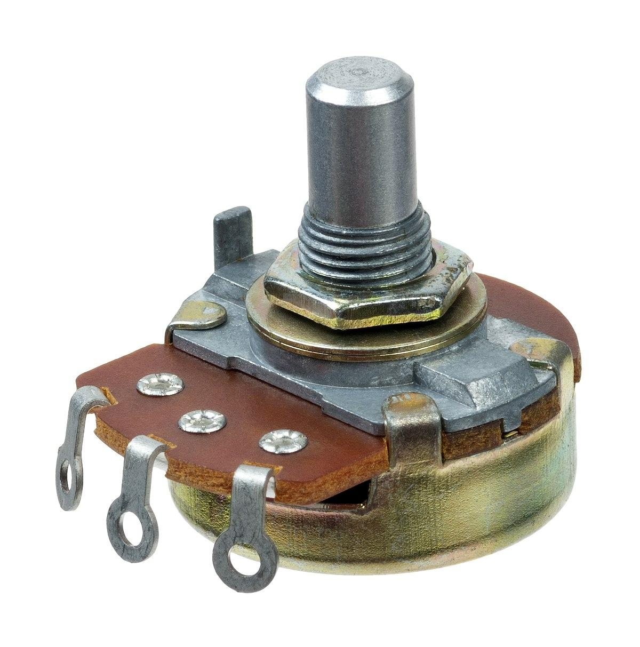
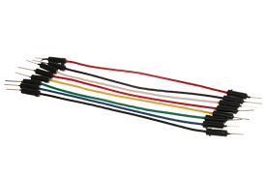
Component Used
Jumper wire
Jumper cables is a smaller and more bendable corrugated cable which is used to connect antennas and other components to network cabling.
Potentiometer
A potentiometer is a three-terminal resistor with a sliding or rotating contact that forms an adjustable voltage divider. If only two terminals are used, one end and the wiper, it acts as a variable resistor or rheostat
Jumper Wire
Potentiometer

Slide 7
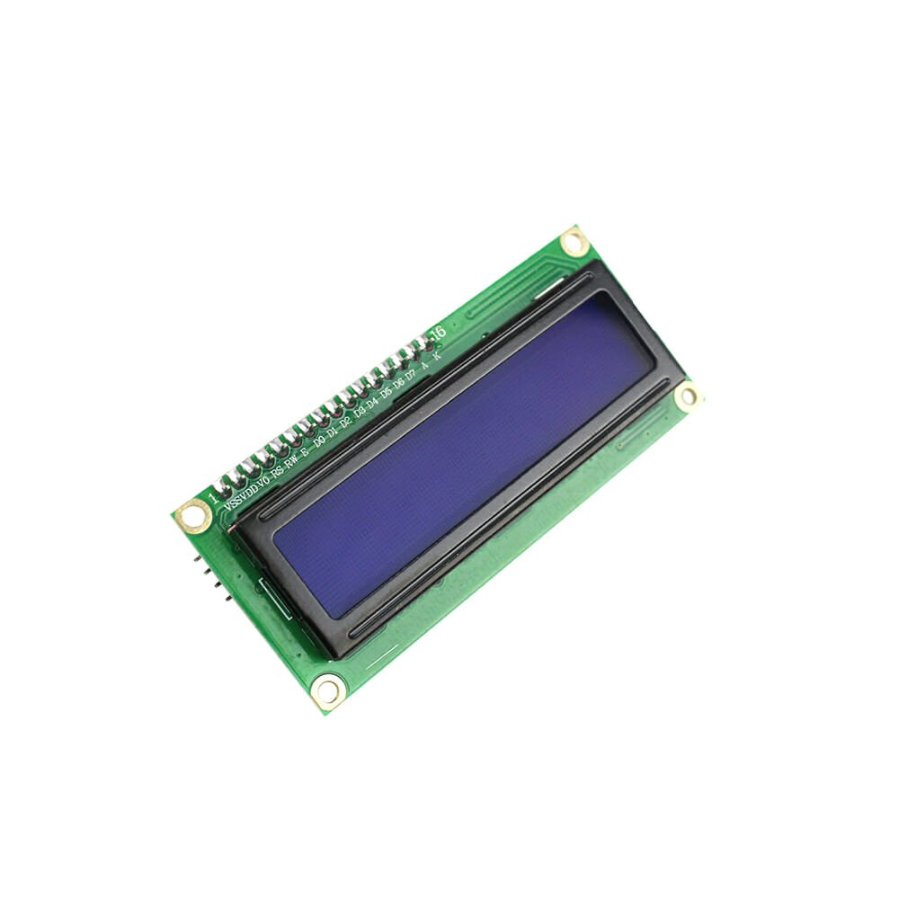
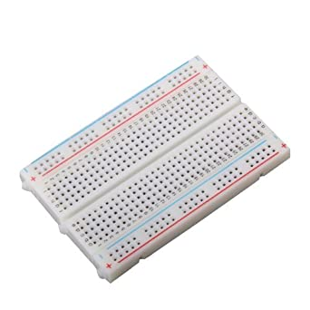
Component Used
LCD display
A liquid-crystal display (LCD) is a flat-panel display or other electronically modulated optical device that uses the light-modulating properties of liquid crystals
Bread Board
A breadboard is a solderless device for temporary prototype with electronics and test circuit designs. Most electronic components in electronic circuits can be interconnected by inserting their leads or terminals into the holes and then making connections through wires where appropriate.
LCD display
Bread Board

Slide 8
Embedded system
An embedded system is a microprocessor-based computer hardware system with software that is designed to perform a dedicated function, either as an independent system or as a part of a large system. At the core is an integrated circuit designed to carry out computation for real-time operations
Embedded system Application
Smart Homes
Most of the products in your home are embedded which gives excellent experience and comfort to the user. Examples are Home Security system, Setup Box, Digital Camera, Television, Microwave Oven, Air cooler, Refrigerator, and much more.

Slide 9
Embedded system Application
Transportation
The automotive industry is well competing worldwide. Some of the Embedded subsystems in automobiles are Anti-lock Braking System (ABS), Air conditioning control, Ignition control, Airbag control, Rain sensing wipers.
Healthcare
The medical field is a critical one, and the use of embedded systems is a nightmare. The odd design may lead to a disastrous effect on society or an individual. Examples are Blood pressure monitors, Heartbeat monitors, pacemakers, telesupervision and surgery, Scanners, Portable Ventilators.

Slide 10
Embedded system Application
Industrial world
The recent challenges of embedded systems extended its scope towards automation. Automation is the process of doing a task repetitively. Automation increases machine productivity, reducing development cost and design time. Examples are Industrial machinery and control, Temperature monitoring, 3D printing machines, Robotics, and Industrial Internet of Things.
Aerospace and Defense
Aerospace and Defense is a rugged area where security and performance are most important. To achieve this reliable firmware and embedded software have to be built. Examples are Flight control systems, Actuation, Air and Thermal Management, Engine power, Vehicle turbochargers, Navigation system, Embedded Imaging.

Slide 11

Tools and Packages
Arduino IDE ( for coding )
Tinkercad.com (online simulation )

Slide 12
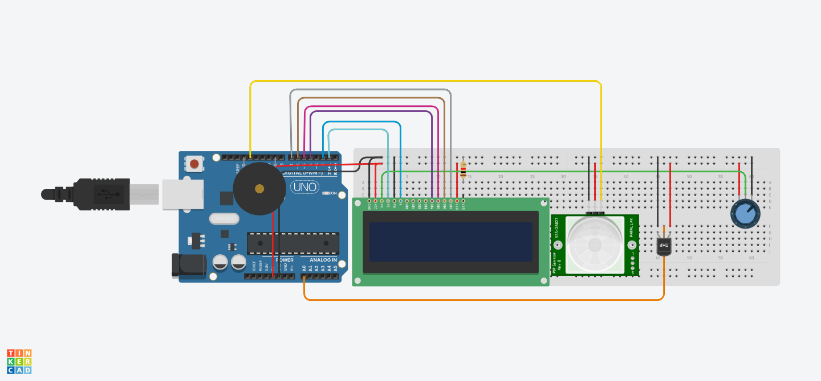
Block Diagram

Slide 13
Methodology
To develop this project we need all the sensors together
Connect the sensors and actuators
Code in the arduino ide for the testing
When code start working
Making the same connection in tinkercad
Run the simulation

Slide 14
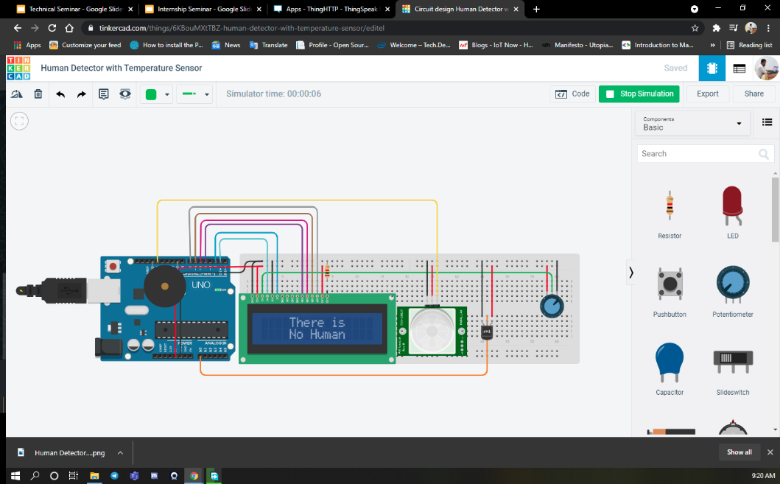
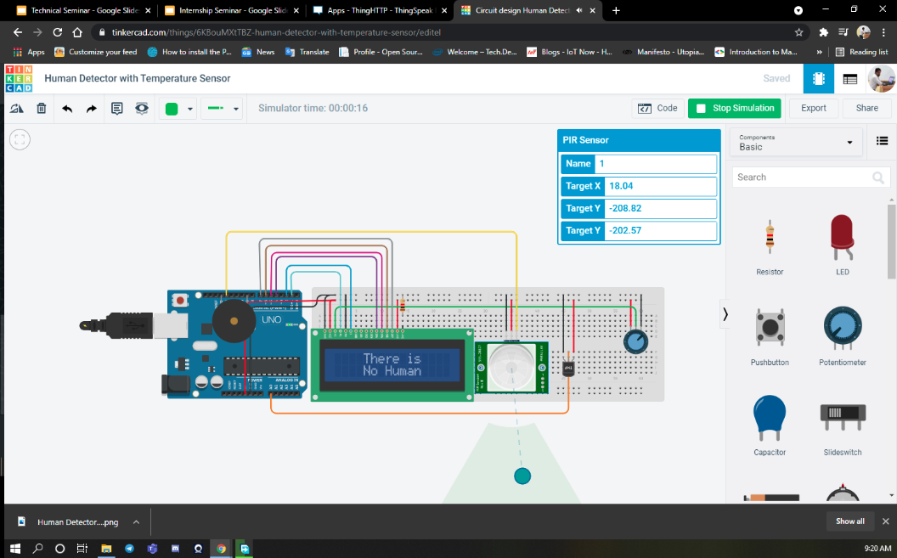
Conclusion
This project will give a safe feeling when installed in home like if someone come to home first it detect motion than after the motion take the temperature .

